Slide 1

Lesson 15: Spring Framework

Slide 2
Agenda
Overview
Spring Platform
Spring Framework
Inversion of Control
Dependency Injection

Slide 3

Overview
Spring is the most popular application development framework that provides a comprehensive programming and configuration model for modern Java-based enterprise applications - on any kind of deployment platform.
First version was released at October 2002
Latest version is 5.3.3 (as of January 2021)

Slide 4
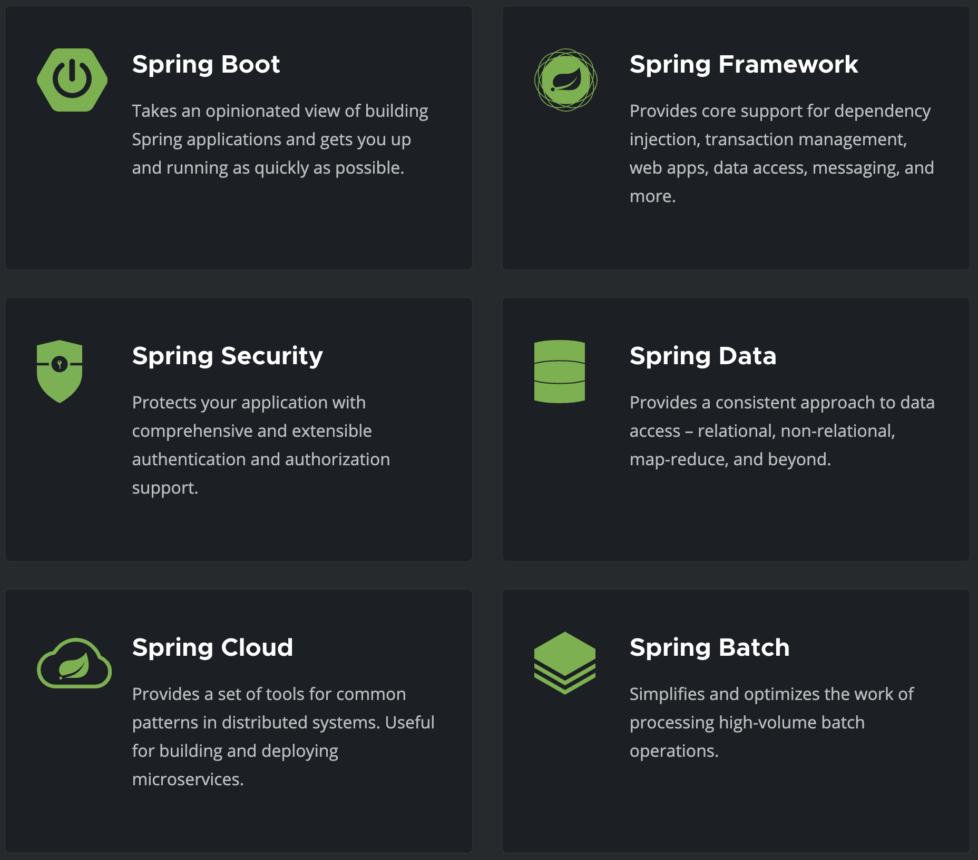
Spring Platform projects, more at Spring Projects

Slide 5
Spring Framework Features
Core technologies: dependency injection, events, resources, i18n, validation, data binding, type conversion, SpEL, AOP.
Testing: mock objects, TestContext framework, Spring MVC Test, WebTestClient.
Data Access: transactions, DAO support, JDBC, ORM.
Spring MVC and Spring WebFlux web frameworks.
Integration: email, tasks, scheduling, cache.
Languages: Kotlin, Groovy, dynamic languages.

Slide 6
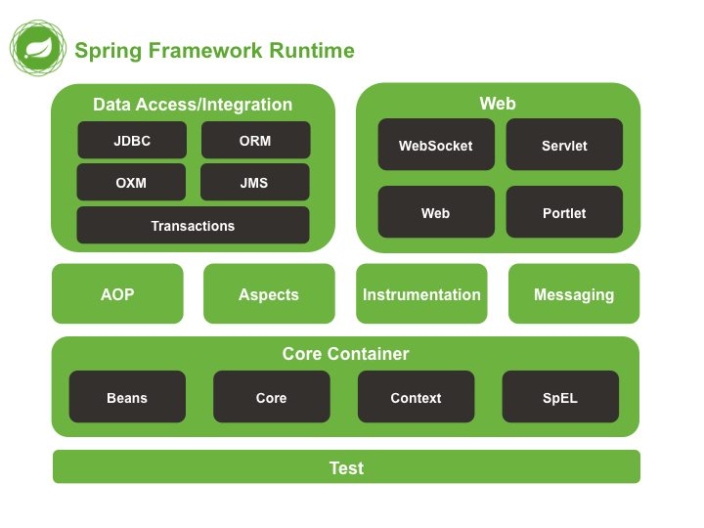
Spring Framework Runtime

Slide 7
Spring Framework - Core Container
The Core module provides the fundamental parts of the framework, including the IoC and Dependency Injection features.
The Bean module provides BeanFactory which is a sophisticated implementation of the factory pattern.
The Context module builds on the solid base provided by the Core and Beans modules and it is a medium to access any objects defined and configured.
The Expression Language module provides a powerful expression language for querying and manipulating an object graph at runtime.

Slide 8
Spring Framework - Data Access
The JDBC module provides a JDBC-abstraction layer that removes the need to do tedious JDBC related coding.
The ORM module provides integration layers for popular object-relational mapping APIs, including JPA, JDO, Hibernate, and iBatis.
The Transaction module supports programmatic and declarative transaction management.

Slide 9
Spring Framework - WEB
Spring's Web MVC (model-view-controller) provides basic web-oriented integration features such as multipart file-upload functionality and the initialization of the IoC container using servlet listeners and a web-oriented application context, also provides a clean separation between domain model code and web forms
The WebFlux reactive-stack web framework, Spring WebFlux, was added later in version 5.0. It is fully non-blocking, supports Reactive Streams, and runs on such servers as Netty, Undertow, and Servlet 3.1+ containers.

Slide 10
Spring AOP
Spring' AOP module provides an AOP Alliance-compliant aspect-oriented programming implementation allowing you to define, for example, method-interceptors and pointcuts to cleanly decouple code that implements functionality that should be separated.
The separate Aspects module provides integration with AspectJ.

Slide 11
Inversion of Control - The Problem?
🤔

Slide 12
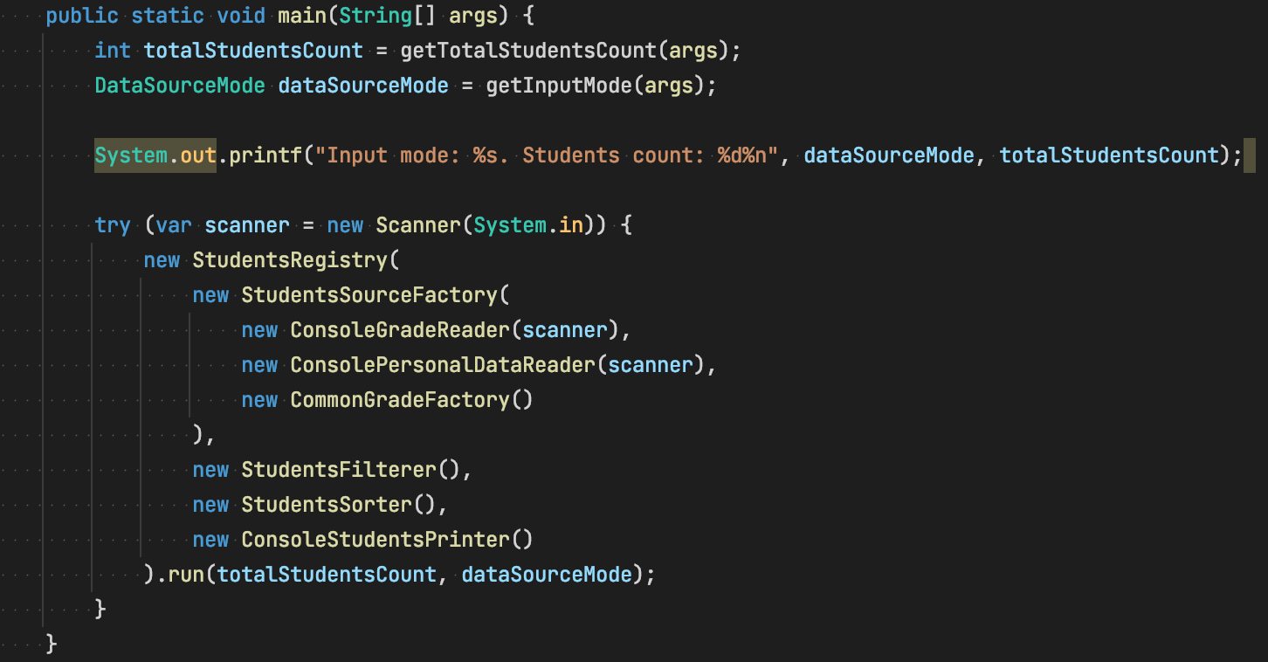
Inversion of Control - The Problem?

Slide 13
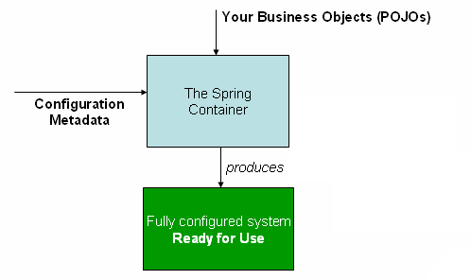
Inversion of Control

Slide 14
Inversion of Control in Spring
The Spring container is at the core of the Spring Framework.
The Spring container uses dependency injection (DI) to manage the components that make up an application.
The container will create the objects, wire them together, configure them, and manage their complete lifecycle from creation till destruction.
The container gets its instructions on what objects to instantiate, configure, and assemble by reading configuration metadata provided. The configuration metadata can be represented either by XML, Java annotations, or Java code.

Slide 15
Dependency Injection Containers
Spring BeanFactory Container - this is the simplest container providing basic support for DI. There are a number of implementations of the BeanFactory interface that come supplied straight out-of-the-box with Spring. The most commonly used BeanFactory implementation is the XmlBeanFactory class.
Spring ApplicationContext Container - includes all functionality of the BeanFactory, and adds more enterprise-specific functionality such as the ability to resolve textual messages from a properties file and the ability to publish application events to interested event listeners.

Slide 16

Example - Hello World
https://github.com/vrudas/spring-framework-examples/tree/main/example-00-hello

Slide 17
Example - Containers
https://github.com/vrudas/spring-framework-examples/tree/main/example-01-bean-factory

Slide 18

What is Bean?

Slide 19
Beans
The objects that form the backbone of your application and that are managed by the Spring IoC container are called beans.
A bean is an object that is instantiated, assembled, and otherwise managed by a Spring IoC container. These beans are created with the configuration metadata that you supply to the container, for example, in the form of XML <bean/> definitions which you have already seen in previous chapters.

Slide 20
Beans - Definition
The bean definition contains the information called configuration metadata which is needed for the container to know the followings:
How to create a bean
Bean's lifecycle details
Bean's dependencies

Slide 21
Beans - Definition
Property | Description
class | The bean class to be used to create the bean.
name | The unique bean identifier.
scope | The scope of the objects created from a particular bean definition.
lazy-initialization mode | Tells the IoC container to create a bean instance when it is first requested, rather than at startup.
constructor-args | Used to inject the dependencies into the class through a class constructor
properties | Used to inject the dependencies into the class through setter methods
initialization method | A callback to be called just after all necessary properties on the bean have been set by the container.
destruction method | A callback to be used when the container containing the bean is destroyed.

Slide 22
Example - Bean Definition
https://github.com/vrudas/spring-framework-examples/tree/main/example-02-bean-definition

Slide 23
Beans - Scopes
Property | Description
singleton | This scopes the bean definition to a single instance per Spring IoC container (default).
prototype | This scopes a single bean definition to have any number of object instances.
request* | This scopes a bean definition to an HTTP request.
session* | This scopes a bean definition to an HTTP session.
application* | When beans are application scoped, the same instance of the bean is shared across multiple servlet-based applications running in the same ServletContext, while singleton scoped beans are scoped to a single application context only.
websocket* | When first accessed, WebSocket scoped beans are stored in the WebSocket session attributes. The same instance of the bean is then returned whenever that bean is accessed during the entire WebSocket session. We can also say that it exhibits singleton behavior, but limited to a WebSocket session only.

Slide 24
Example - Bean Scope
https://github.com/vrudas/spring-framework-examples/tree/main/example-03-bean-scope

Slide 25
Beans - Lifecycle
The life cycle of a Spring bean is clear to understand.
When a bean is instantiated, it may be required to perform some initialization to get it into a usable state.
When the bean is no longer required and is removed from the container, some cleanup may be required.

Slide 26
Beans - Lifecycle - Initialization
The org.springframework.beans.factory.InitializingBean interface specifies a single method:
void afterPropertiesSet() throws Exception;
In the XML-based configuration metadata, you can use the init-method attribute to specify the name of the method that has a void no-argument signature:
<bean id="..." class="..." init-method="init"/>
Annotate the method with @PostConstruct:
@PostConstruct
public void init() {
...
}

Slide 27
Beans - Lifecycle - Destruction
The org.springframework.beans.factory.DisposableBean interface specifies a single method:
void destroy() throws Exception;
In the XML-based configuration metadata, you can use the init-method attribute to specify the name of the method that has a void no-argument signature:
<bean id="..." class="..." destroy-method="destroy"/>
Annotate the method with @PreDestroy:
@PreDestroy
public void destroy() {
...
}

Slide 28
Beans - Multiple Lifecycle Mechanisms
Multiple lifecycle mechanisms configured for the same bean are called in the following order:
Initialization:
Methods annotated with @PostConstruct
afterPropertiesSet() as defined by the InitializingBean callback interface
A custom configured init() method
Destruction:
Methods annotated with @PreDestroy
destroy() as defined by the DisposableBean callback interface
A custom configured destroy() method

Slide 29
Example - Beans Lifecycle
https://github.com/vrudas/spring-framework-examples/tree/main/example-04-bean-lifecycle

Slide 30
Dependency Injection
When writing a complex Java application, application classes should be as independent as possible of other Java classes to increase the possibility to reuse these classes and to test them independently of other classes while doing unit testing.
Dependency Injection (or sometime called wiring) helps in gluing these classes together and same time keeping them independent.

Slide 31
Dependency Injection - The Problem?
🤔

Slide 32
Dependency Injection
When writing a complex Java application, application classes should be as independent as possible of other Java classes to increase the possibility to reuse these classes and to test them independently of other classes while doing unit testing.
Dependency Injection helps in combining these classes together and same time keeping them independent.

Slide 33
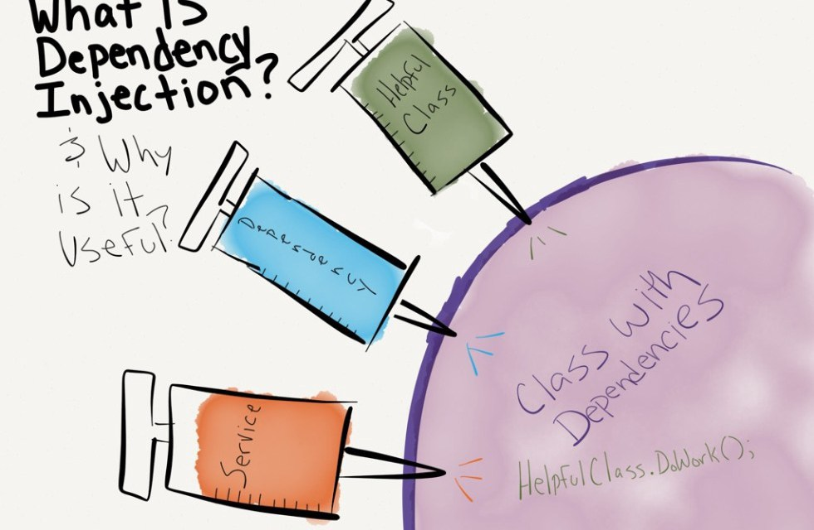
Dependency Injection

Slide 34
Dependency Injection Types
Constructor-based DI - is accomplished when the container invokes a class constructor with a number of arguments, each representing a dependency on other class.
Setter-based DI - is accomplished by the container calling setter methods on your beans after invoking a no-argument constructor or no-argument static factory method to instantiate your bean.
Field-based DI - we can inject the dependencies by marking them with an @Autowired annotation:

Slide 35
Example - Dependency Injection
https://github.com/vrudas/spring-framework-examples/tree/main/example-05-dependency-injection

Slide 36
Annotation Based Configuration (since Spring 2.5)
@Autowired | Marks a constructor, field, setter method, or config method as to be autowired by Spring's dependency injection facilities.
@Qualifier | used on a field or parameter as a qualifier for candidate beans when autowiring.
@Component | Indicates that an annotated class is a "component". Such classes are considered as candidates for auto-detection when using annotation-based configuration and classpath scanning.
@Service | Indicates that a class is used for code of a "Business Logic". This annotation is a general-purpose stereotype and individual teams may narrow their semantics and use as appropriate.
@Repository | Indicates that an annotated class is a "Repository" - a mechanism for encapsulating storage, retrieval, and search behavior which emulates a collection of objects".
JSR-250 Annotations | Spring supports JSR-250 based annotations which include @Resource, @PostConstruct and @PreDestroy annotations.

Slide 37
Example - Annotation Based Configuration
https://github.com/vrudas/spring-framework-examples/tree/main/example-06-annotation-config

Slide 38
Java Based Configuration
Framework independent approach without XML usage
Operates with additional annotations:
@Configuration indicates that the class can be used by the Spring IoC container as a source of bean definitions.
@Bean annotation tells Spring that a method annotated with @Bean will return an object that should be registered as a bean in the Spring application context.

Slide 39
Example - Java Based Configuration
https://github.com/vrudas/spring-framework-examples/tree/main/example-07-java-config

Slide 40

Properties

Slide 41
Example - Properties
https://github.com/vrudas/spring-framework-examples/tree/main/example-08-properties

Slide 42
Any questions?
🤔

Slide 43
Homework
Add spring IOC to the project
Set up bean creatin and injection to the Services(use layered architecture Repository-Service-Controller)
Write realization to add products in the Bucket and Order them
Generate and save to file check/bill for order

